Slide 1

Jaypee University of Engineering & Technology, Guna (MP)
Project Name - University Publication Portal
Project Number – 33
Project Members: Project Guide:
Abhinav Singh Parmar (171B010) Dr. Nilesh kumar R. Patel
Anuhar Tripathi (171B036)

Slide 2
Motivation for Project
Every faculty has papers / articles published in National & International journal’s.
Managing the research work of faculties in the university is the main issue.
HOD’s and the department co-ordinator’s have to manage the articles / papers of their respective department.
To manage the articles / papers, a university publication management system is needed. So that all the articles / papers can be handled at a single place.
So that better controllability and management can be established.
2

Slide 3
Background
Article has four types :
Journal
Conference
Book chapter
Books
Indexing can be either :
Sci
Scopus
PubMed
Ici
Other
3

Slide 4
University Publication Portal
University Publication Portal provides a simple way to search university publications & articles from one place.
Members can add and locate their articles / papers through their library on the web and can check who is citing their publications.
Every members can pull review request for their articles by specifying the other members.
The HOD’s can view / manage articles of members in their respective department and can assign different role(Associate Professor, Assistant Professor) to the members in their department.
Department co-ordinator can view / manage articles of members in their respective department.
The university co-ordinator can access all the publications of university and can assign different role( HOD, Associate Professor, Assistant Professor) to the members.
4

Slide 5
Queries
Add / Remove authors, categories of authors( HOD only).
Add / Remove / Edit articles.
Check if article is present given its article id. If yes article id, title, year should be listed.
Check articles written by authors of department( HOD only).
Request review of article by senior authors of department.
Check number of citation on articles / papers.
Answer the review request.
And so on.
5

Slide 6
Entity Type: Author
Every author has author_id, name, dob, gender, mobile_no, email, department (CSE, ECE,
MEC, CIVIL), post(HOD, Associate Professor, Assistant Professor).
Entity Type:
Author
Attributes:
Author_id – is unique
Name (composite)
Dob
Gender
Mobile_no – may be null
Email
Department
Post (HOD, Associate Professor, Assistant Professor)
6

Slide 7
Entity Type: Co-Authors
Some articles may be contributed by more than one author. Co-Authors store author_id, name.
Entity Type:
Co-Authors
Attributes:
Author_id – is unique
Name (composite)
7

Slide 8
Entity Type: Article
Every article has type( Journal, Conference, Book Chapter, Books).
Entity Type:
Article
Attributes:
Article_id – is unique
Title
Indexing (sci, scopus, PubMed, ici, other)
8

Slide 9
Entity Type: Article
Entity Type:
Book_Chapter
Attributes:
Publication_House
Date
Location
Entity Type:
Journal
Attributes:
Journal_Name
Vol_No
Issue_No
Page_No
9

Slide 10
Entity Type: Article
Entity Type:
Conference
Attributes:
Conference_Name
Location
Date
Page_No
Entity Type:
Books
Attributes:
Publication_House
Date
Isbn_No
Accession_NO
10

Slide 11
Relational Schema
Author (author_id, name, dob, gender, mobile_no, email, department, post).
Co-Author (author_id, name).
Article (Author_id, Title, Indexing)
Book_Chapter (Publication_House, Date, Location)
Journal (Journal_Name, Vol. no, Issue, Page_No)
Conference (Conference_Name, Location, Date, Page_No)
Book (Publication_House, Date, Isbn_No, Accession_No)
Review_Request (Article_Id, Author_Id)
Alerts (Article_Id, Author_Id)
11

Slide 12
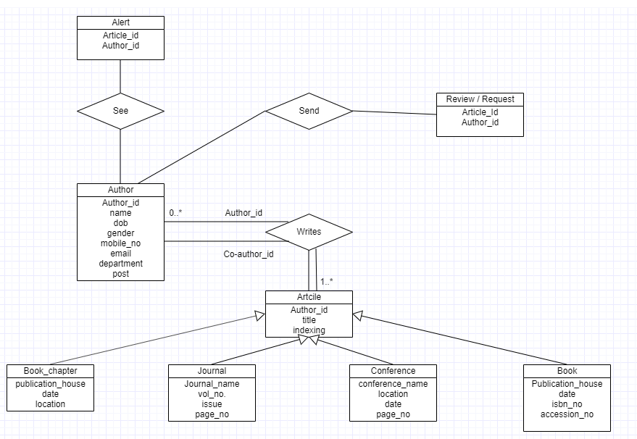
ER-Diagram
12

Slide 13
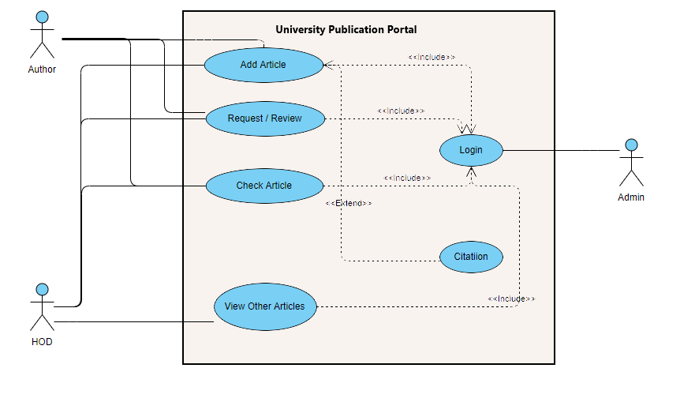
Use Case Diagram
13

Slide 14
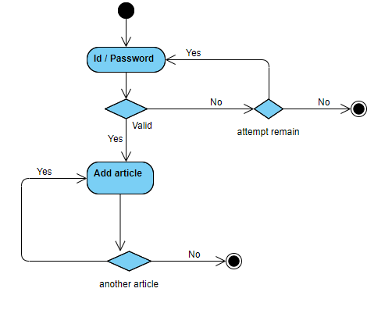
Add Article
14

Slide 15
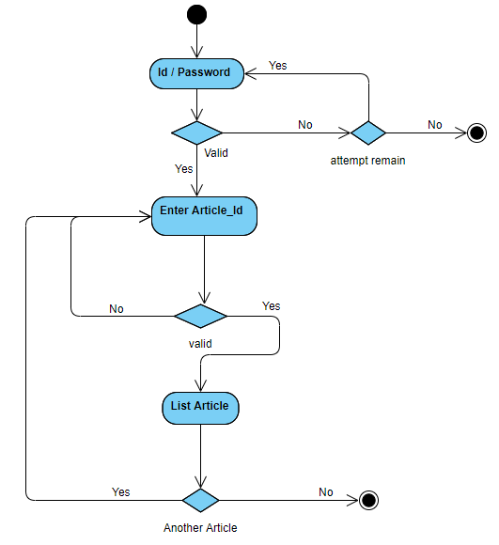
Search Article
15

Slide 16
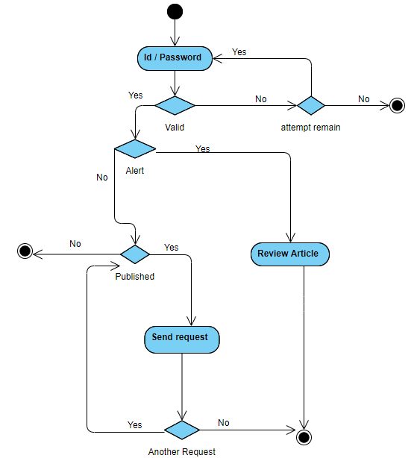
Review / Request
16

Slide 17
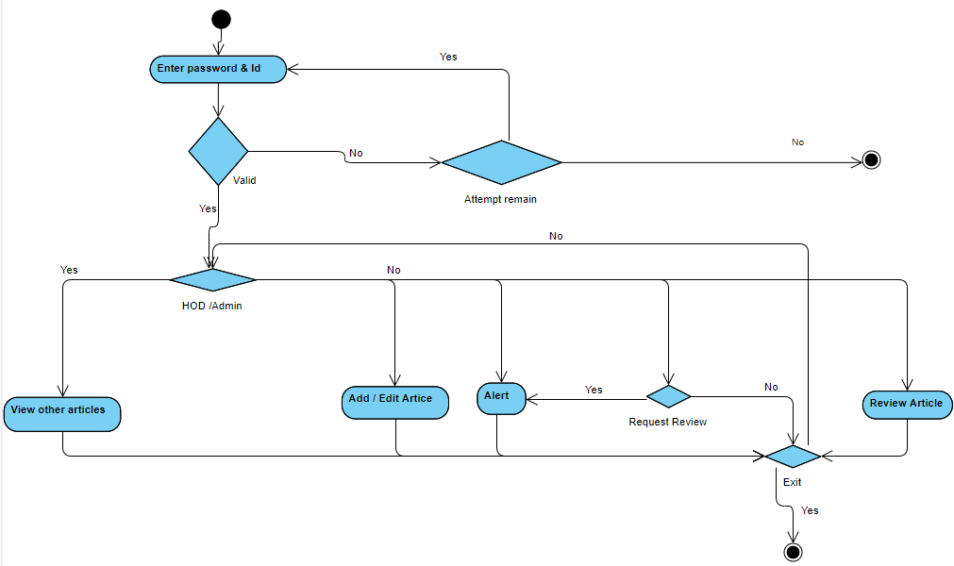
Activity Diagram
17

Slide 18
Language Used
HTML / CSS
JavaScript
React js
Node js
18

Slide 19
Thank You
19

